Slide 1
Quale spazio per il bendaggio gastrico?
Francesco Furbetta M.D.
pisa

Slide 2
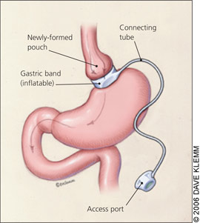
Mercoledì 1 Ottobre 2025 - 348ª Seduta pubblica ddl n. 1483 riconosce l'obesità come malattia cronica, progressiva e recidivante con approccio basato su:
prevenzione
educazione sanitaria
presa in carico multidisciplinare di malattia epigenetica
paziente tipo: età tra 18-60 aa; BMI 42
rieducazione stile di vita
terapia farmacologica
chirurgia bariatrica
sinergia d’azione attuale e futura
regolabilità e reversibilità
efficace e sicuro nel lungo termine
modulazione/miglior risultato

Slide 3
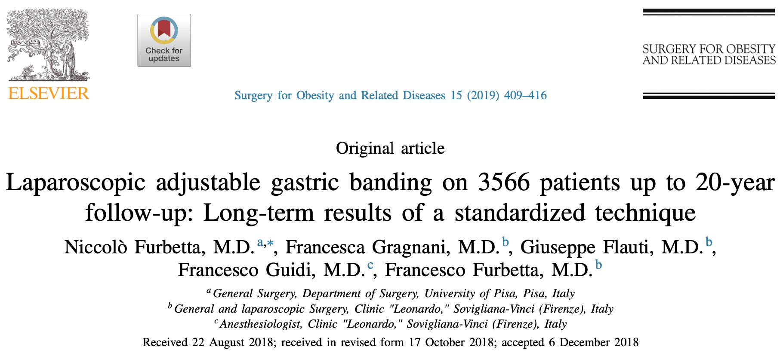
Il bendaggio gastrico nel contesto del team:
funziona nel lungo termine
dopo 20 aa
sicuro e “facile”
no mortalità
no complicanze maggiori
“facile” post-operatorio
55% follow-up
56%EWL
“There have been no deaths associated with any primary gastric banding procedure or any subsequent revisional procedure.” OBES SURG (2019) 29:3–14 P. E. O’Brien

Slide 4
Il bendaggio oggi
È un percorso di cura interdisciplinare
accorgimenti tecnici = no erosioni
team e nuovi farmaci = risultati preliminari a 6 mesi
controllo dilatazioni
controllo peso
ex-obeso senza bendaggio (268 oggi)
Integrazione farmaci
restaurazione
sequenzialità
regolabilità e reversibilità:
prerogative esclusive per un
irrinunciabile miglior risultato

Slide 5
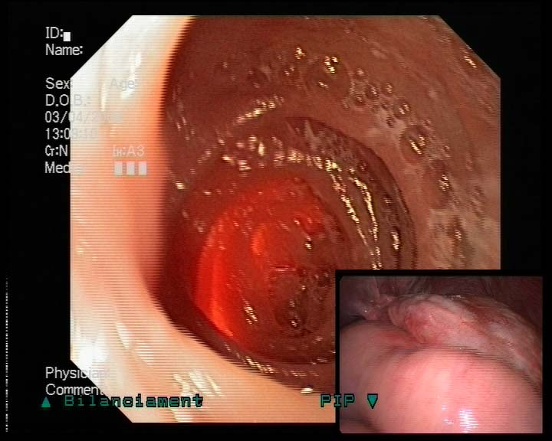
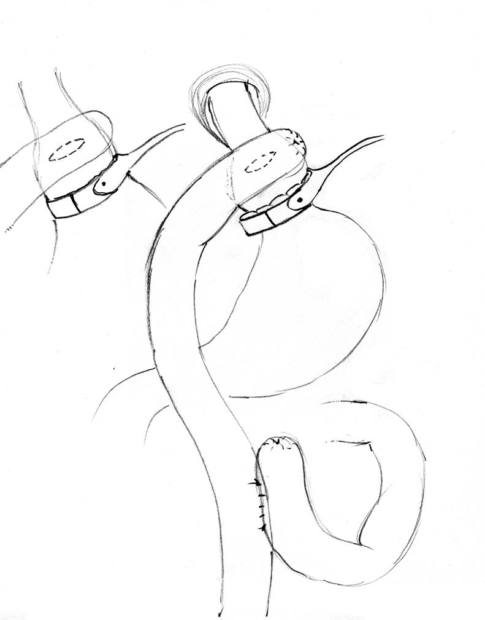
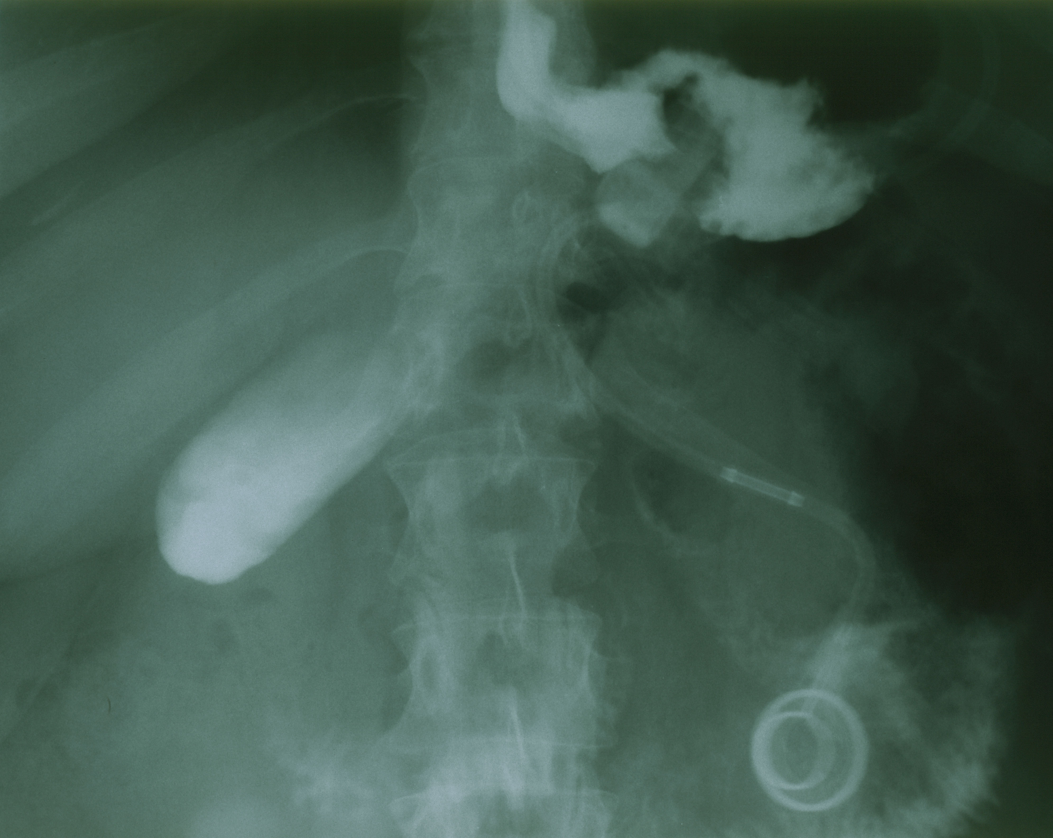
Percorso di cura
sequenzialità per no-compliance/fallimenti
V° meeting bioenterics January 25-28 2001
1° white weekend Italian group Lap Band (GILB) Fiera di Primiero (S. Martino di Castrozza) Functional Gastric Bypass: F. Furbetta video chair F. Favretti
Functional Gastric Bypass (FGB) inflated banding

Slide 6
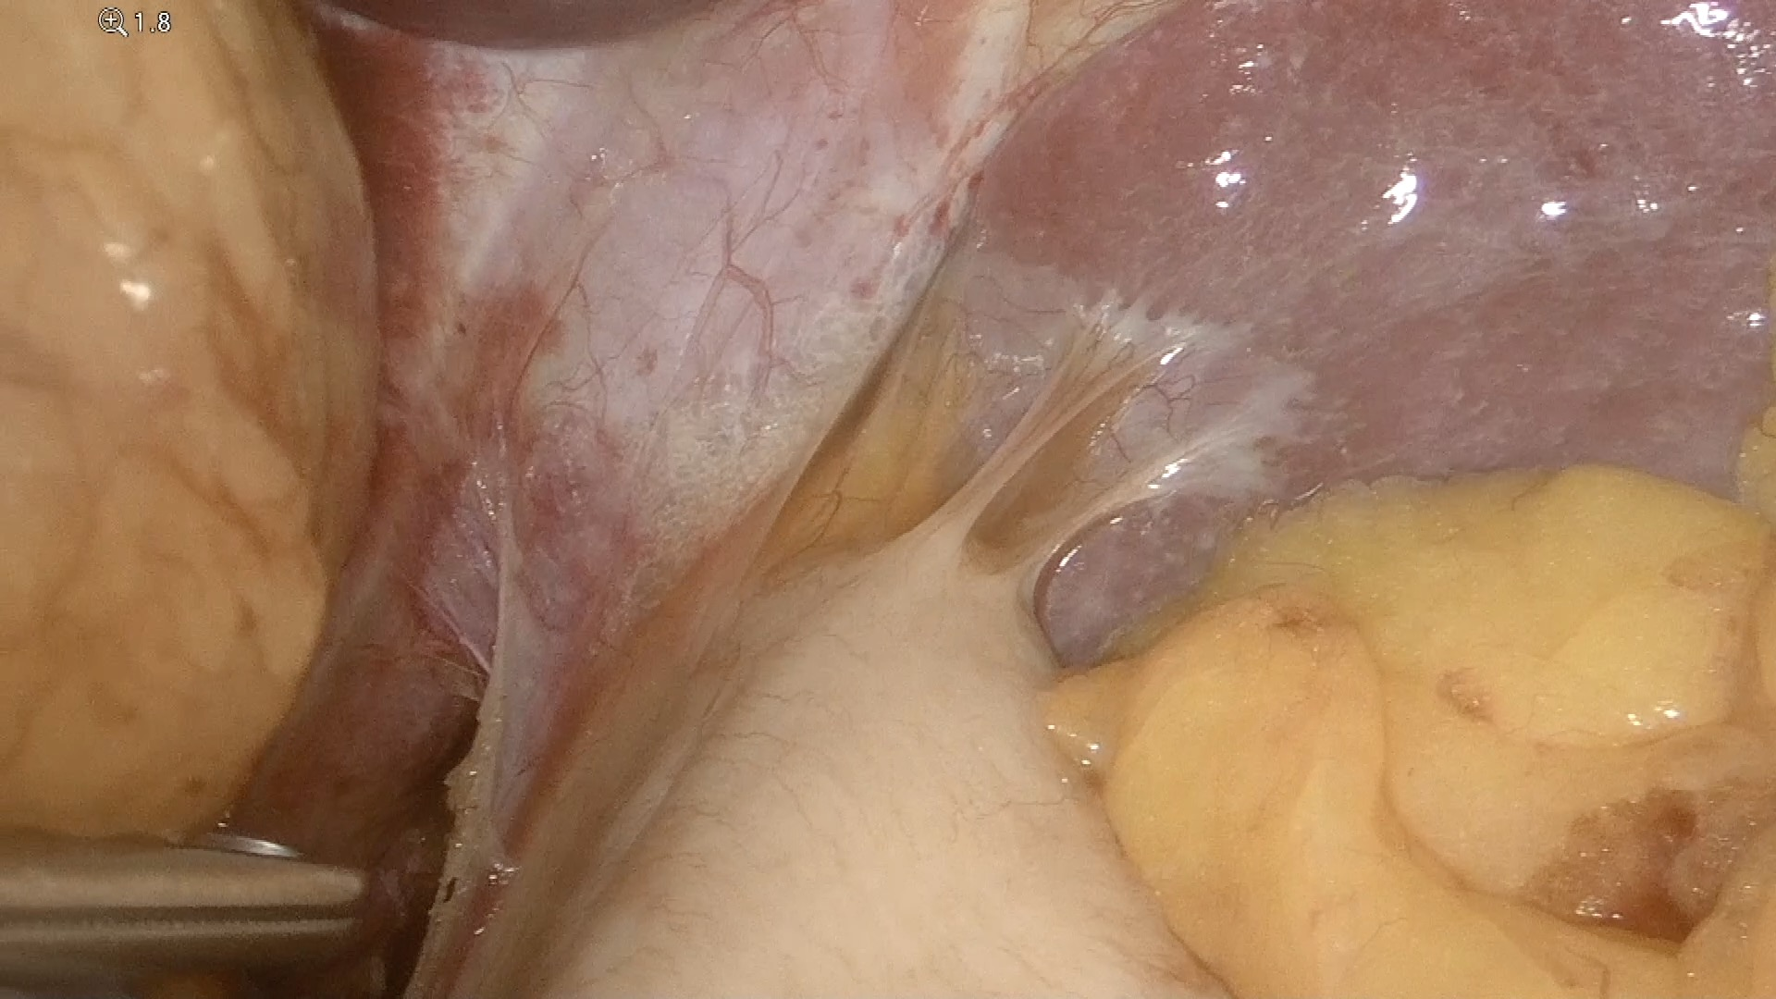
La chirurgia bariatrica/metabolica oggi
Il lungo termine
uno scomodo criterio che
svaluta la chirurgia
e allora
ridotto a 3-5 aa
aderenza al F-U 30%
eccellenza= N° interventi
procedure fattibili
non reversibili
segmenti esclusi
di cui “SI SA” poco
il fondo gastrico per riflettere

Slide 7

Un esempio calzante per mettere ordine
Therapeutic advances in obesity management: an overview of the
Therapeutic interventions. Frontiers in Endocrinology; 2024.
the basis of obesity is not genetic (7). The evidence suggests that genes often need to be closely linked with environmental and lifestyle risk factors to affect weight (8). Currently, lifestyle interventions including physical activity and diet are the first-line management
La breast unit
Il “chirurgo” bariatrico
interdisciplinarietà
e
integrazione terapeutica
esaltazione della prestazione
decoro professionale
paziente
giovane con BMI di 42

Slide 8
CONSIDERAZIONE - Il razionale dello spazio per il bendaggio
Il paziente ha un percorso di cura efficace e sicuro nel lungo termine
team
bendaggio gastrico
sicuro ed efficace
minimamente invasivo
regolabile
reversibile
concreta indicazione
no-trattamenti in eccesso
no-effetti collaterali a lungo termine
soluzioni alternative e in divenire - nuovi farmaci
no
trattamento multidisciplinare:
chiave del successo
e
“limite” del bendaggio
no
restaurazione
sequenzialità

Slide 9
Spero di mantenere un equilibrio e di utilizzare le nuove soluzioni per il benessere del paziente
la “breast unit” un esempio calzante
Il mio messaggio:
faccio oggi ciò di cui sarei soddisfatto
se incontrassi il mio paziente tra…20 anni

Slide 10
Grazie

Slide 12
Ten‐Year Results of Laparoscopic Sleeve Gastrectomy: a Retrospectively Designed Study of a Single Tertiary Center Obesity Surgery (2023) 33:173–178
Yet only 35% maintain a %EWL of more than 50%. Arman et al. [24] reported a conversion rate of 31.7% at 11.7 years after SG. de-novo GERD rate of 25.7–58.4%. It is of major importance to follow-up, diagnose, monitor, and treat chronic post-SG de novo GERD as they may advance to Barret’s esophagus and increase cancer risk.
Efficiency and safety of single anastomosis sleeve ileal (SASI) bypass in the treatment of obesity and associated comorbidities: a systematic review and meta-analysis
Langenbeck's Archives of Surgery (2024) 409:221
SASI bypass could be an important tool in the future, but there is a need for studies with longer fol-
low-up periods (> 12 months) to confirm the efficiency and safety of this surgical technique.variations included the length of the common limb, which varied between 200 and 350 cm; the size of the gastro-ileal anastomosis, which was 3–4 cm; and the gastro-ileal anastomosis proximal to the pylorus, which ranged
between 3 and 6 cm.
Recommendations to standardise

Slide 13
Surgery for Obesity and Related Diseases 14 (2018) 665-673
Patients’ preferences for information in bariatric surgery
information provision is based on 3 pillars: to verify patients’understanding of the provided information during theconsult, to discuss the in uence of surgery for daily life,
and to approach them as individuals.

Slide 14
IFSO Update Position Statement on One Anastomosis Gastric Bypass (OAGB). Obesity Surgery (2021) 31:3251–3278
pouch length, i.e., 20 cm (n=180) [109], and the other in terms of pouch volume, i.e., 50–60 cc.
including 3 RCTs [34, 40, 109]. In the RCTs, the length of the BPL was 200 cm in 227 patients [34, 109], 150 to 180 cm in 101 individuals. In the remaining literature there is no homogeneity regarding this item.
Given the short- term nutritional outcomes and the anatomical changes that are made with this operation, it will be important in the future to document the risk of protein malnutrition, anemia and hypovitaminosis. On the basis of current knowledge, the impact of factors such as the BPL length and patient starting BMI will be important variables to consider.

Slide 15
Obes Surg 2023 Jan;33(1):219-223.
Frequency of Short- vs Long-Term Reporting of Bariatric Surgery Outcomes
It is mostly beyond the 2-year period after surgery that factors like weight loss stabilization, weight loss failure, weight regain, or re-emergence of comorbidities become apparent. With the rise in numbers of different bariatric surgical techniques, long-term outcomes are crucial in identifying the long-term effects of these. The collected data was categorised for further analysis into short-term (< 3 years), medium-term (≥ 3 and < 5 years), and long-term (≥ 5 years) as per ASMBS reporting guidance.
Editorial
Precision Bariatric/Metabolic Medicine and Surgery Precision Bariatric/Metabolic Medicine and Surgery. J. Clin. Med. 2023,
Recently pharmacological treatments for obesity have emerged.
Bariatricians should also rethink bariatric patient care pathways and, more specifically, postoperative follow-up.
The impact of patient‐reported outcomes on loss to follow‐up care after bariatric surgery Surgical Endoscopy https://doi.org/10.1007/s00464-021-08352-x
fewer than 10% continue to have follow-up within 10 years of surgery [4–8]. Nationwide loss to follow-up is a problem that plagues both bariatric patient care and research efforts designed to study the long-term efficacy of these procedures [9].
Making sense of gastric/intestinal bypass surgeries: forget the name and remember the degree of restriction and malabsorption the surgeries provide
Surgery for Obesity and Related Diseases 13 (2017) 716–719
the stomach size and limb length for these bariatric surgeries make it difficult to judge whether they are restrictive or malabsorptive in nature.

Slide 16
Emerging Procedures in Bariatric Metabolic Surgery Surg Clin N Am 101 (2021) 335–353
Each bariatric procedure should be identified by a single set of precise anatomic measurements that characterize its final anatomic reconfiguration standard
Standardization of Bariatric Metabolic Procedures: World Consensus Meeting Statement
Obesity Surgery (2019) 29 (Suppl 4):S309–S345
We are metabolic surgeons working in an era of evidence- based medicine. As surgical scientists, we must report a consistent technique in the international research literature to facilitate reproducibility and comparison of results. The best technique is the most effective and safe approach at a given time. They require that exact intraoperative measurements of the final anatomic configurations be agreed upon and consistently employed (e.g., limb lengths, orifice outlets).
Follow-up after bariatric surgery: are we effective enough? Videosurgery Miniinv 2022; 17 (2): 299–302
Although these values are highly unsatisfactory in the 1-year follow-up, they get worse on a 2-year basis because less than 1 in 10 patients had follow-up data collected at that time. follow-up may also allow bariatric surgery studies to obtain data that genuinely reflect the features of this treatment.
Small Bowel Limb Lengths and Roux-en-Y Gastric Bypass: a Systematic Review OBES SURG DOI 10.1007/s11695-016-2050-2
Reported lengths of BPL and AL varied widely from 10–250 to 35–250 cm, respectively, in a survey of 215 American bariatric surgeons

